Slide 1
Decision Tree
Kelompok 3
Kevin Angga Wijaya (05111840000024)
Angelita Titiandes Silalahi (05111840000088)
Aflakah Nur Farhana (05111840000120)

Slide 2
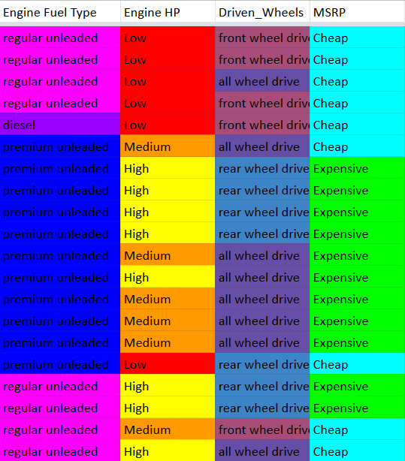
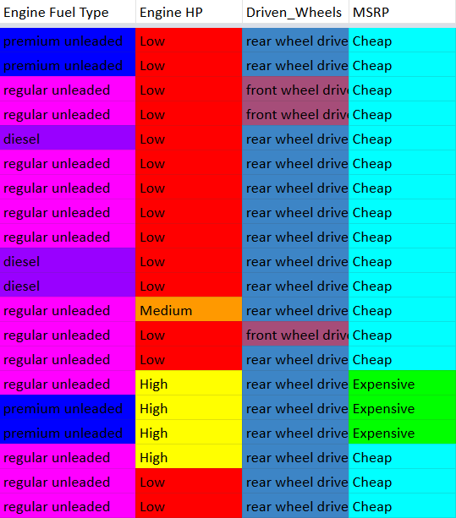
Data

Slide 3
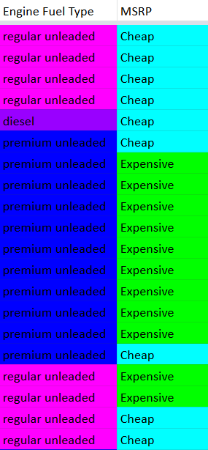
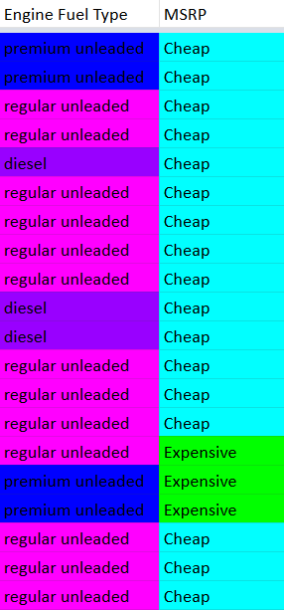
Engine Fuel Type
Engine Fuel Type(14+, 26-)
Regular Unleaded(3+, 18-)
Diesel(0+, 4-)
Premium Unleaded(11+, 4-)

Slide 4
Engine Fuel Type
Entropy(S)
= Entropy([14+, 26-])
=
= 0.934
Entropy(Diesel)
= Entropy([0+, 4-])
=
= 0
Entropy(Premium Unleaded)
= Entropy([11+, 4-])
=
= 0.837
Entropy(Regular Unleaded)
= Entropy([3+, 18-])
=
= 0.592
Gain(S, Engine Fuel Type)
=
= 0.310

Slide 5
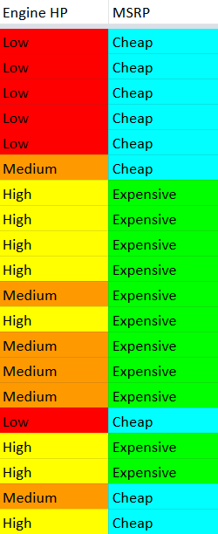
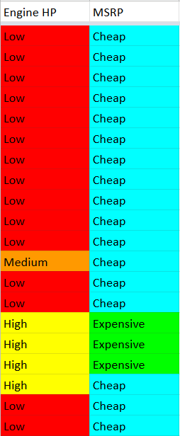
Engine HP
Engine HP(14+, 26-)
Low(0, 21-)
Medium(4+, 3-)
High(10+, 2-)
Entropy(S) = 0,934
Entropy(Low) = 0
Entropy(Medium) = 0,985
Entropy(High) = 0,650
Gain(S) = 0,567

Slide 6
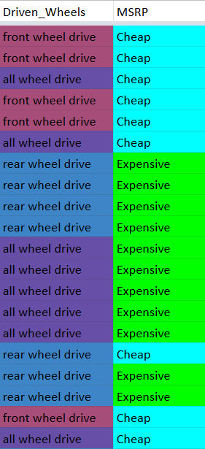
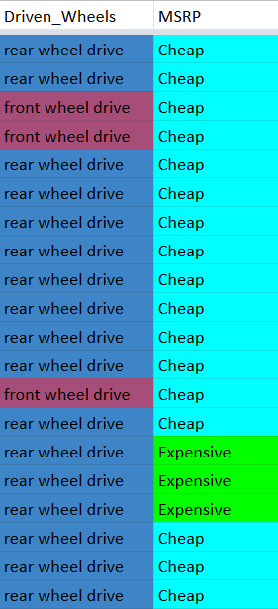
Driven Wheels
Driven Wheels(14+, 26-)
Front Wheel Drive(0, 21-)
All Wheel Drive(4+, 3-)
Rear Wheel Drive(10+, 2-)
Entropy(S) = 0,934
Entropy(Front Wheel Drive) = 0
Entropy(All Wheel Drive) = 0,954
Entropy(Rear Wheel Drive) = 0,954
Gain(S) = 0,171

Slide 7
Atribut yang memiliki gain terbesar adalah ‘Engine HP’.
Karena untuk Engine HP medium dan high belum dapat ditentukan golongan MSRP-nya, maka harus dilakukan iterasi lagi untuk masing masing data dengan Engine HP Medium dan Engine HP High.
Engine HP
Low
Medium
High
Cheap
?
?

Slide 8
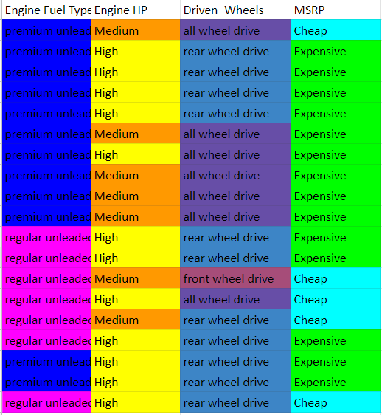
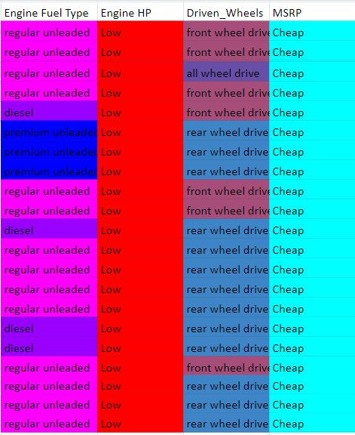
Tabel data untuk perhitungan selanjutnya
Melakukan remove pada baris yang memiliki engine HP Low karena MSRP sudah pasti cheap. Beriku merupakan
gambar tabel yang
telah diremove

Slide 9
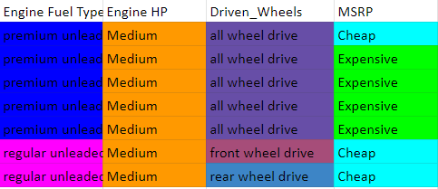
Tabel data dengan Engine HP medium

Slide 10
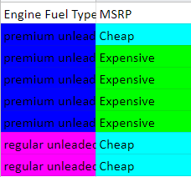
Engine fuel type (with Engine HP medium)
EngineFuel TypeP(4+, 3-)
Premium unleaded(4, 1-)
Regular unleaded(0, 2-)
Entropy(S) = 0,985
Entropy(Premium unleaded) = 0,72
Entropy(Regular unleaded) = 0,00
Gain(S) = 0,470

Slide 11
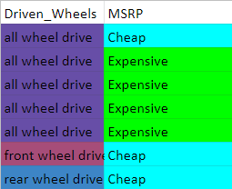
Driven wheel (with Engine HP medium)
Driven Wheels(4+, 3-)
Front Wheel Drive(0, 1-)
All Wheel Drive(4+, 1-)
Rear Wheel Drive(0+, 1-)
Entropy(S) = 0,985
Entropy(Front Wheel Drive) = 0
Entropy(All Wheel Drive) = 0,722
Entropy(Rear Wheel Drive) = 0,00
Gain(S) = 0,418

Slide 12
Engine HP
Low
Medium
High
Cheap
Engine Fuel Type
?
Regular unleaded
Premium unleaded
Cheap
Expensive

Slide 13
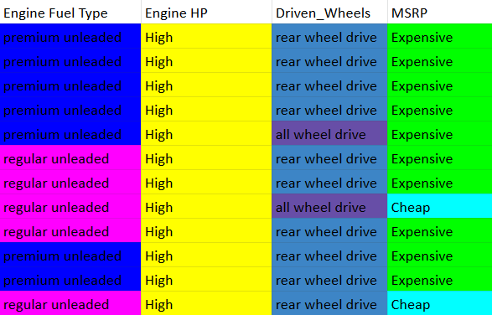
Tabel data dengan Engine HP High

Slide 14
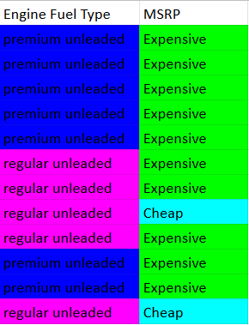
Engine fuel type (with Engine HP high)
Engine Fuel Type (10+, 2-)
Premium unleaded(7+, 0-)
Regular unleaded(3+, 2-)
Entropy(S) = 0.650
Entropy(Premium unleaded) = 0
Entropy(Regular unleaded) = 0.971
Gain(S) = 0.245

Slide 15
Driven wheel (with Engine HP high)
Driven Wheels(4+, 3-)
Front Wheel Drive(0, 1-)
All Wheel Drive(4+, 1-)
Rear Wheel Drive(0+, 1-)
Entropy(S) = 0,650
Entropy(Front Wheel Drive) = 0
Entropy(All Wheel Drive) = 0,722
Entropy(Rear Wheel Drive) = 0,00
Gain(S) = 0,093

Slide 16
Engine HP
Low
Medium
High
Cheap
Engine Fuel Type
Engine Fuel Type
Regular unleaded
Premium unleaded
Regular unleaded
Premium unleaded
Cheap
Expensive
?
Expensive

Slide 17
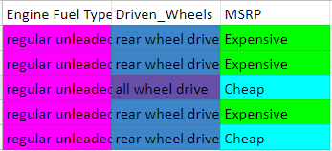
Tabel data dengan Engine fuel type regular unleaded

Slide 18
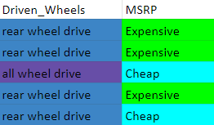
Driven Wheels dengan regular unleaded dan engine type high
Dari tabel dapat disimpulkan bahwa All wheel drive memiliki MSRP cheap dan rear wheel drive memiliki MSRP Expensive

Slide 19
Engine HP
Low
Medium
High
Cheap
Engine Fuel Type
Engine Fuel Type
Regular unleaded
Premium unleaded
Regular unleaded
Premium unleaded
Cheap
Expensive
Expensive
Driven Wheels
All wheel drive
Rear wheel drive
Cheap
Expensive

